Slide 1

EGC3113/EGC3173 _Semester Project
Project Presentation
(Feb 2021 semester)
Date : Apr 2021
(Group Project)
Lecturer:

Slide 2
EGC3113/EGC3173: SEMESTER PROJECT
STUDENT MANAGEMENT SYSTEM
By:
Student Name | Student ID

Slide 3
INTRODUCTION

Slide 4
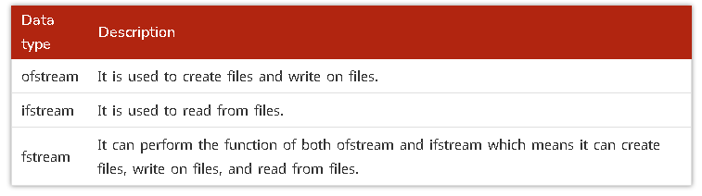
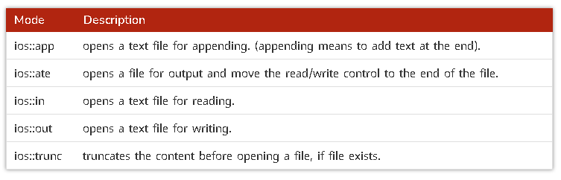
important Keywords used in the project File i/o in C++
Opening a file

Slide 5
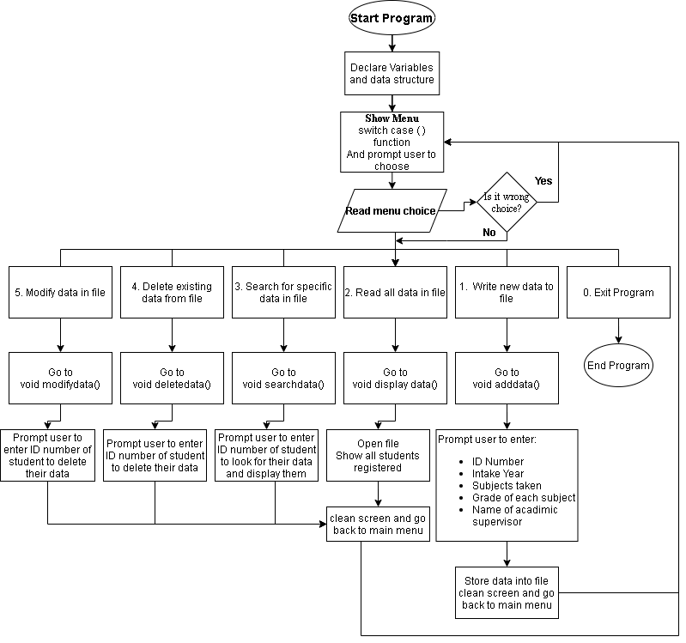
FLOWCHART OF THE PROJECT

Slide 6
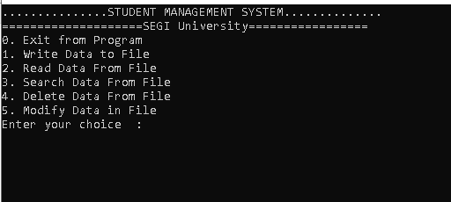
Code explanation
Main Menu for User Interface

Slide 7
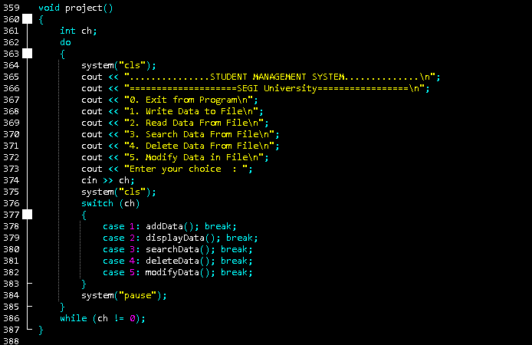
Main Menu Function with Switch /Case

Slide 8
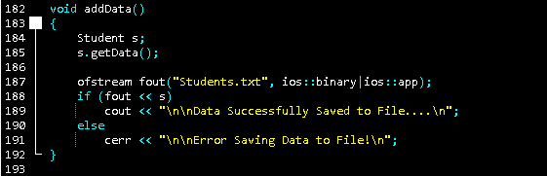
Adding Data To The System Function

Slide 9
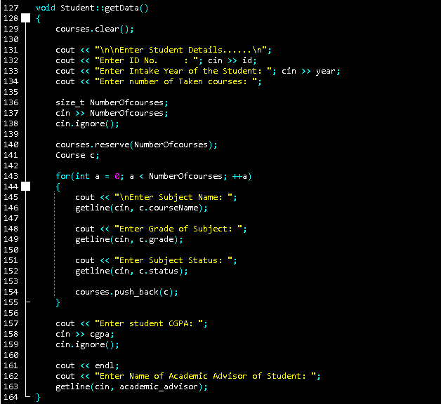
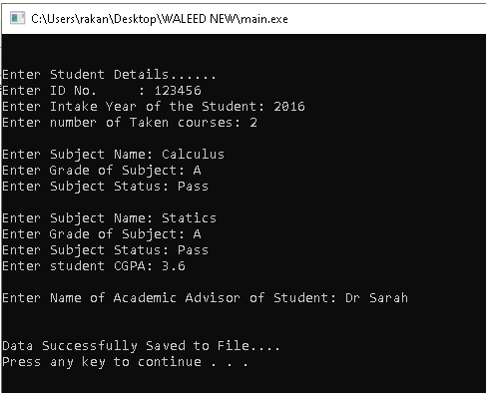
Function To Prompt User To Enter Data

Slide 10
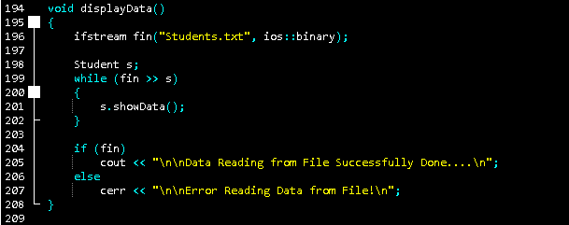
Displaying Data In The System Function

Slide 11
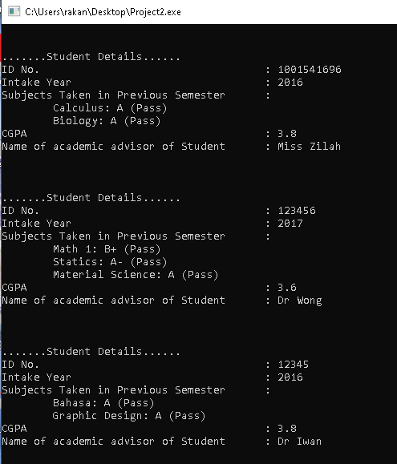
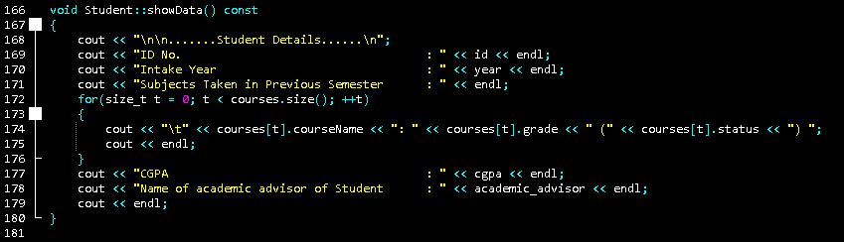
Function To Set Up What Data To Display

Slide 12
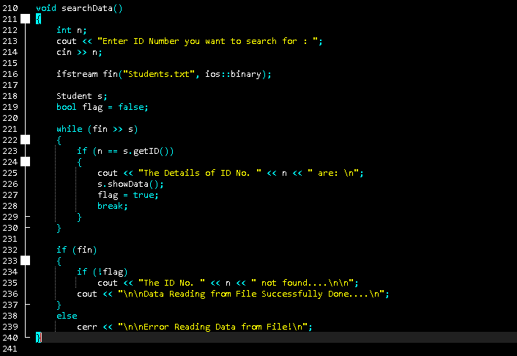
Searching Data In The System Function

Slide 13
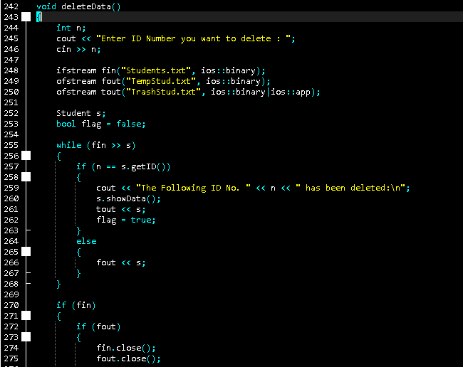
Deleting Data In The System Function

Slide 14
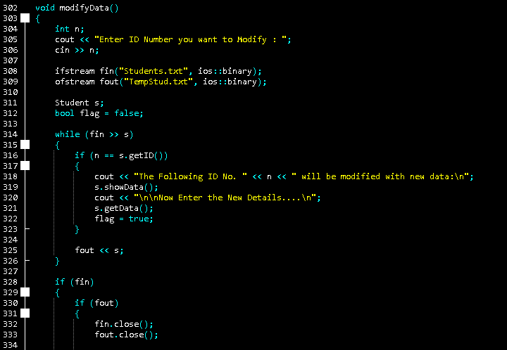
Modifying Data In The System Function

Slide 15
THE END
Thank You for Listening

